Slide 1


Streaming queries without compromise
Mihai Budiu – .
September 18, 2024

Slide 2
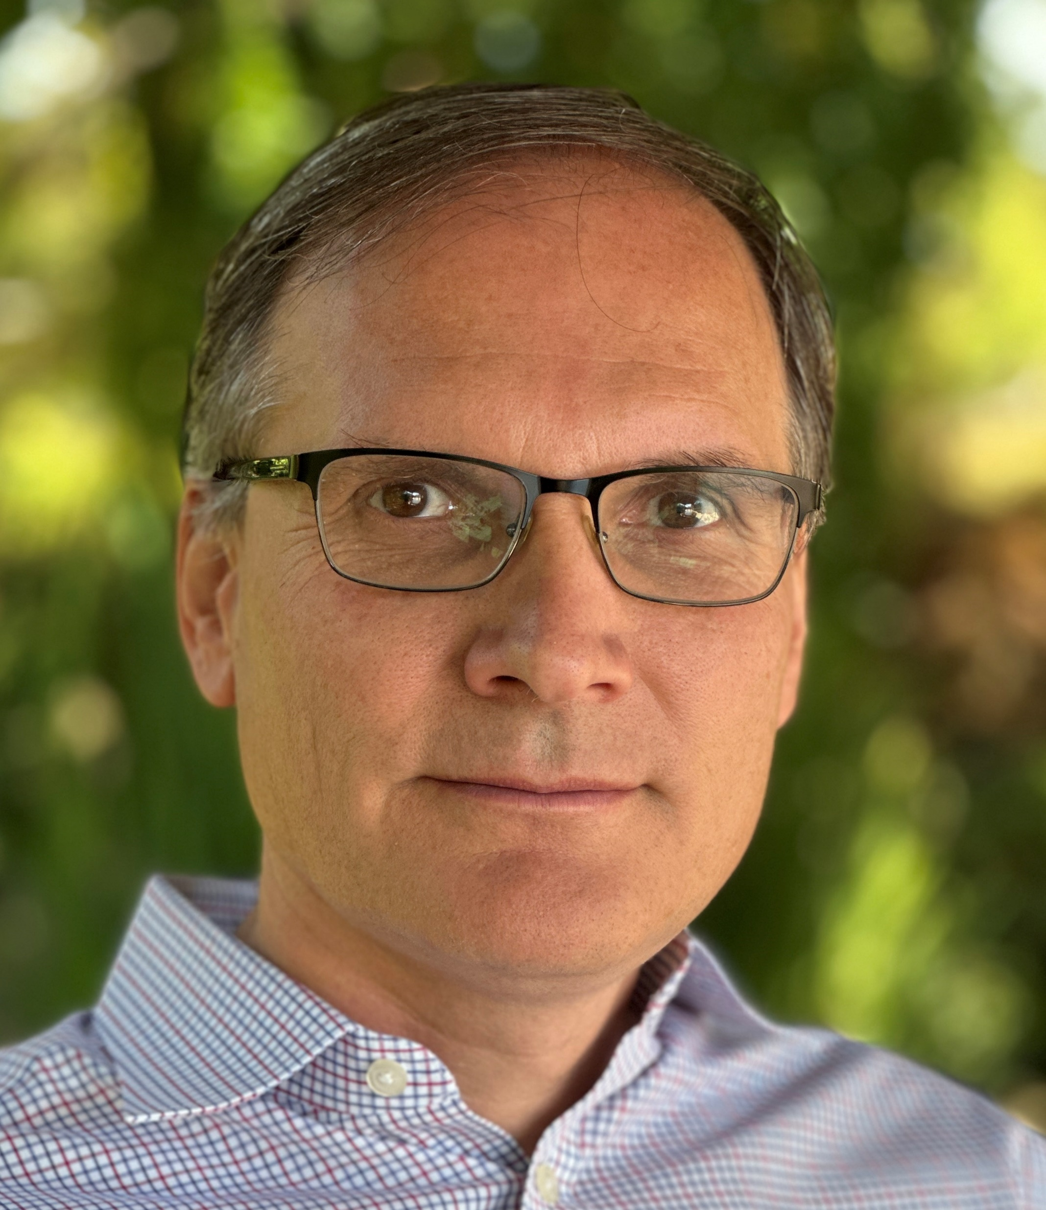
Mihai Budiu - Short bio
Ph.D. from Carnegie Mellon in CS
Microsoft Research Silicon Valley
Barefoot Networks
VMware Research
feldera.com – chief scientist
Apache Calcite PMC member
https://mihaibudiu.github.io

Slide 3
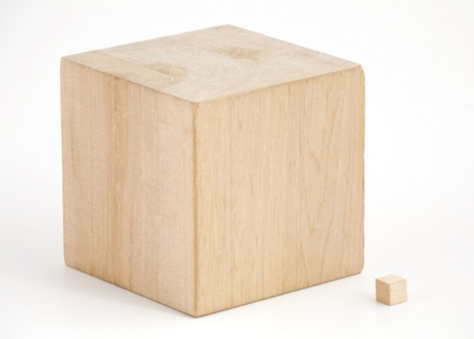
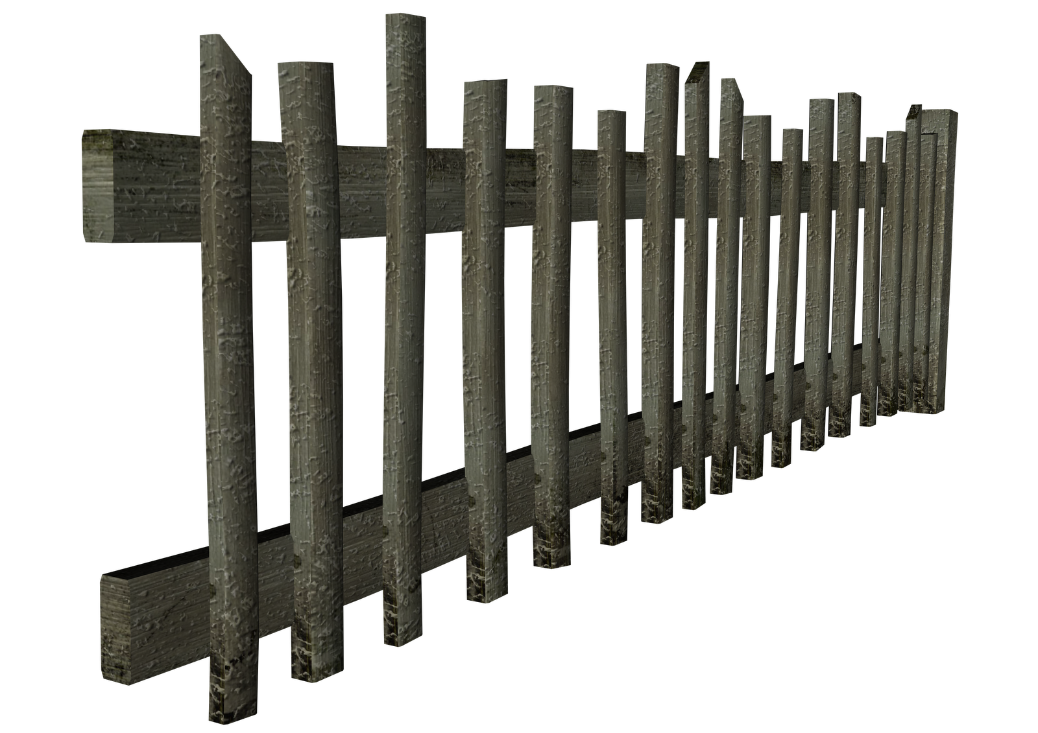
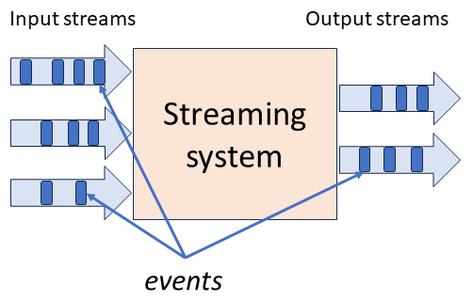

stream
DB
IVM
IVM
Database

Slide 4


If you want to know more
ACM SIGMOD 2024 Research
Highlights
Award
DBSP: Automatic Incremental View Maintenance for Rich Query Languages Mihai Budiu, Tej Chajed, Frank McSherry, Leonid Ryzhyk, Val Tannen
github.com/feldera/feldera
Best paper award

Slide 5

No compromises!
Any SQL queries
Any number of queries, including recursive queries
Any mix of data sources
tables and “streams,” any number of them
Any data changes to the tables and streams, inputs and outputs
insertions, deletions, updates
Incrementally evaluated (work proportional to the size of the changes)
Incremental view maintenance
Exact SQL semantics
Fully deterministic execution, transactional semantics, “strong consistency”
Simple data representation and algorithms
Uniform data and change representation and computation
Computations on unbounded streams
using finite memory

Slide 6



Setup: A database and a query
$$Q$$

Slide 7

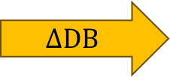

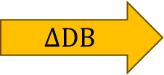



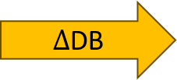

Periodic query evaluation
CREATE VIEW V AS SELECT … FROM …
V
V
V
V
V
$$Q$$
$$Q$$
$$Q$$
$$Q$$
$$Q$$
$Δ$DB
$$ΔDB$$
$$ΔDB$$
$$ΔDB$$
$$ΔDB$$
~100 rows
~1B rows
Time
transactions

Slide 8

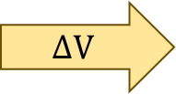


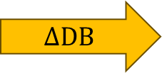


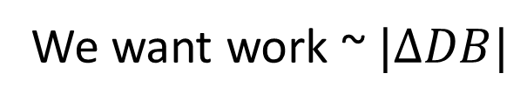



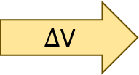
Incremental View Maintenance
We want work ~$|ΔDB|$
V
V
V
V
V
$$ΔV$$
$$ΔV$$
$$ΔV$$
$$ΔV$$
$Δ$V
$$Q$$
$$Q^{Δ}$$
$$Q^{Δ}$$
$$Q^{Δ}$$
$$Q^{Δ}$$
$$Q^{Δ}$$
$$ΔDB$$
$$ΔDB$$
$$ΔDB$$
$$ΔDB$$
$$ΔDB$$
Time

Slide 9
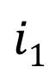

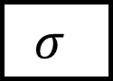
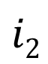
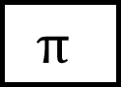

Query plans
Boxes = computations
Arrows = values
$$Q$$
$$i1$$
$$σ$$
$$⋈$$
o
$$i2$$
$$π$$

Slide 10
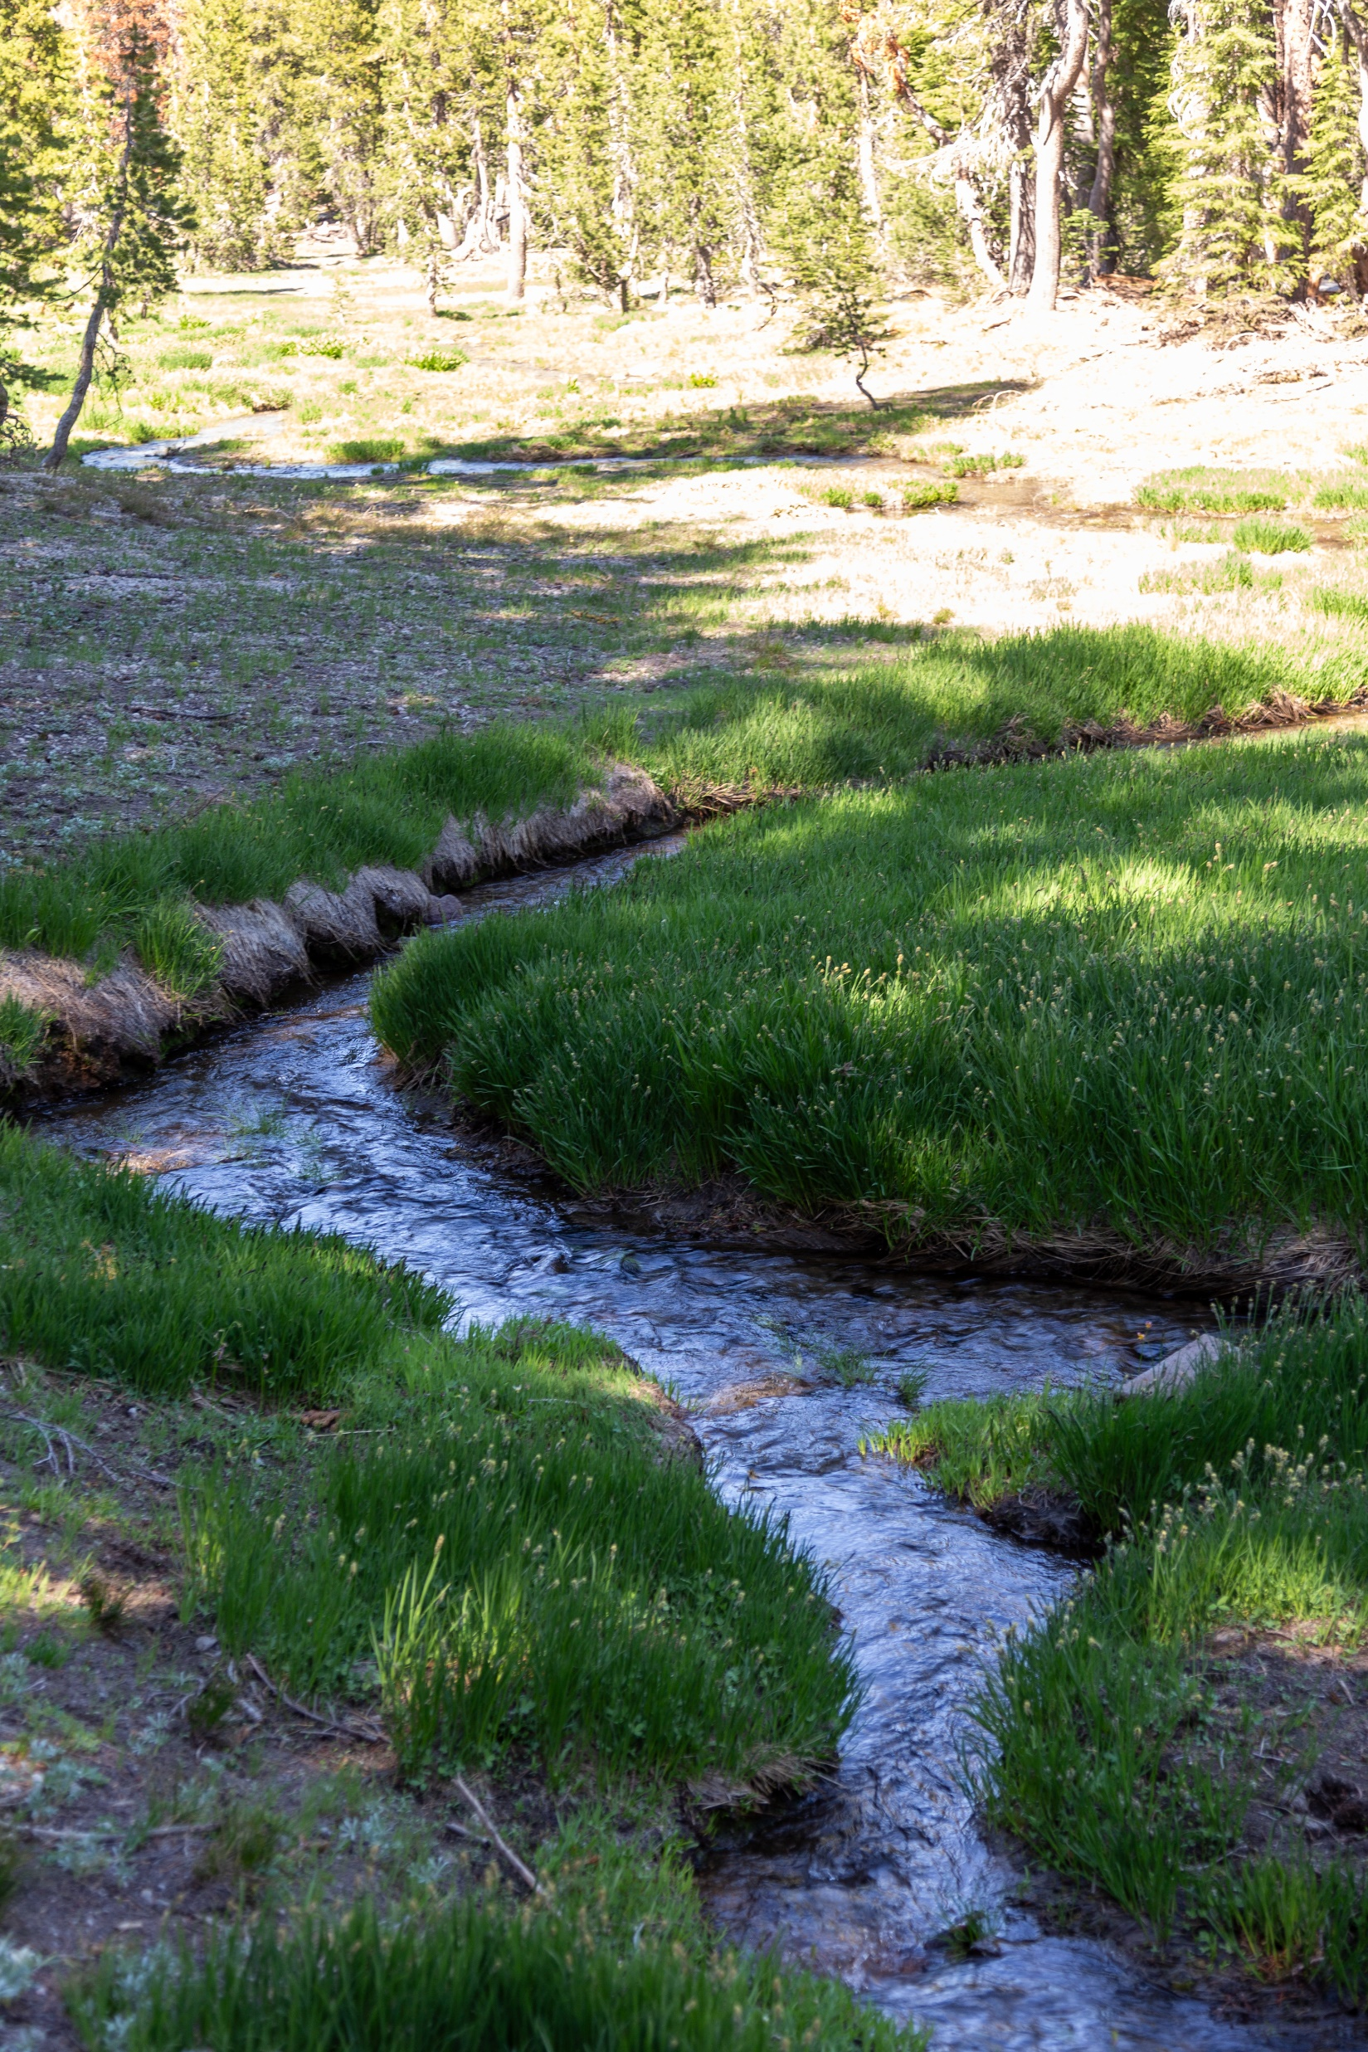
Streams
Infinite sequences
-1
-2
-1
0
1
2
1

Slide 11
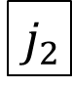
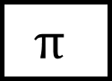
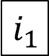
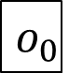

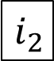
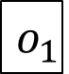
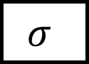
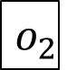
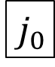
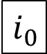
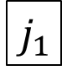
Stream computations
Inputs and outputs are streams
double arrows
…
$$i_{2}$$
$$i_{1}$$
$$i_{0}$$
$$σ$$
$$⋈$$
…
$$o_{2}$$
$$o_{1}$$
$$o_{0}$$
…
$$j_{2}$$
$$j_{1}$$
$$j_{0}$$
$$π$$

Slide 12
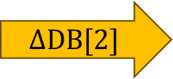
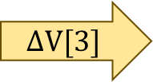
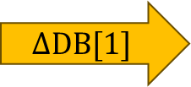

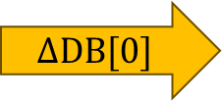
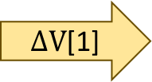
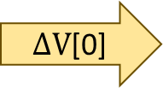
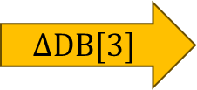
Some interesting streams
Stream of database
snapshots
DB[0]
DB[1]
DB[2]
DB[3]
$$ΔDB[0]$$
$$ΔDB[1]$$
$$ΔDB[2]$$
$$ΔDB[3]$$
… transactions
V[0]
V[1]
V[2]
V[3]
… view
snapshots
$ΔV$[0]
$ΔV$[1]
$$ΔV[2]$$
$$ΔV[3]$$
… view
changes

Slide 13
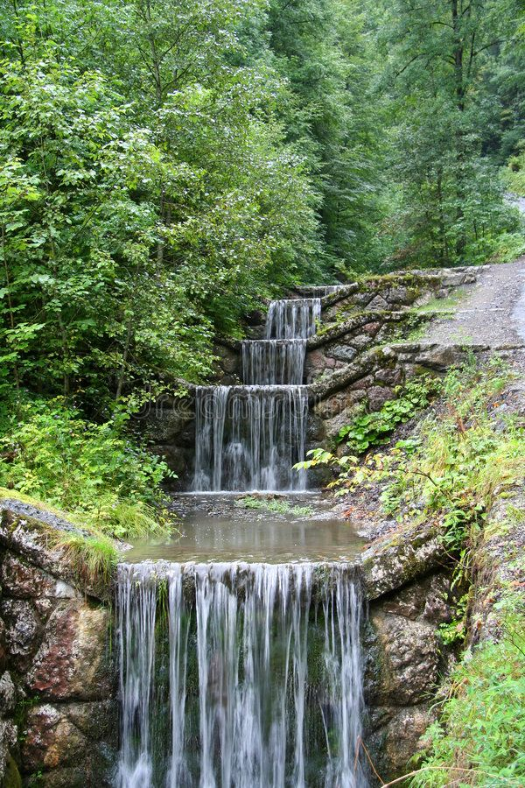
Idea #1
Databases,
transactions,
views, and
view changes
are streams

Slide 14
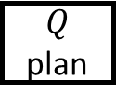
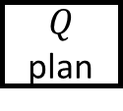

Views are stream computations
$$Q$$
$Q$ plan
V
V
V
V
$Q$ plan

Slide 15


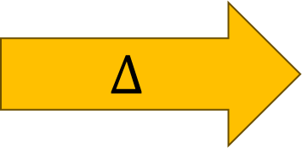
Changes
$$Δ$$
can be read as
-1
+
=
+1

Slide 16
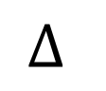
Z-sets: changes with a sign
A change can involve many rows in many tables
Applying a change is addition
-1
+
=
+1
$$Δ$$

Slide 17
A table is a change too!
+1
+
+1
=
+1
+1
+1
zero

Slide 18

Idea #2: Z-sets
Can represent both tables and changes to tables
Positive weights = rows added
Negative weights = rows removed
Can represent sets and multisets
Classic DB table = Z-set where all weights are 1

Slide 19
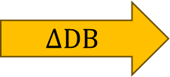


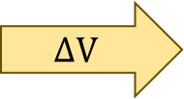
Z-sets could be everywhere!
V
V
Tables and views
Table and view changes
Change Data Capture streams
Database logs
INSERT and DELETE statements
Transactions
$$ΔV$$
$$Q$$
$$Q^{Δ}$$
$$ΔDB$$
Z-sets should be the standard data exchange format

Slide 20
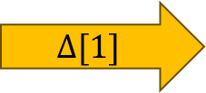
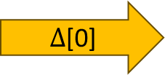
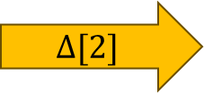
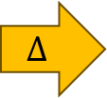

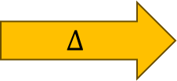
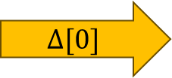
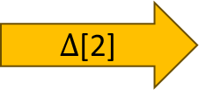
Applying changes = Adding Z-sets
+
=
$$Δ$$
$$Δ$$
DB[0]
DB[1]
DB[0]
DB[1]
…
$Δ$[0]
$$Δ[1]$$
$Δ$[2]
DB[0]
DB[1]
DB[2]
DB[3]
DB[N]
+
+
+
+
…
=
$$Δ[0]$$
$$Δ[1]$$
$$Δ[2]$$
DB[0]
DB[N]
integration

Slide 21

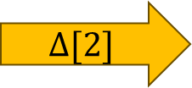
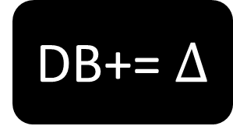


DB+= $Δ$
$$Δ[2]$$
$$Δ[1]$$
$$Δ[0]$$
Stream of experiences

Slide 22






Automatic Incremental View Maintenance
$$Q$$
V
V
$Q$ plan
$$ΔV$$
$$Q$$
$$Q^{Δ}$$
Compiler
$$ΔDB$$
$$ΔDB$$
$$ΔV$$
$$ΔDB$$
$$Q^{Δ}$$
plan
$$ΔV$$
$$ΔDB$$
$$Q^{Δ}$$
$$ΔV$$
$$ΔDB$$
$$ΔV$$

Slide 23


Incremental queries are stateful streaming systems
…
$$i_{2}$$
$$i_{1}$$
$$i_{0}$$
$$Q^{Δ}$$
…
$$o_{2}$$
$$o_{1}$$
$$o_{0}$$
state
$Q^{Δ}$ is a streaming system:
it runs forever
it maintains internal state (even if $Q$ is stateless)

Slide 24







Compilation is dead simple! (in theory)
V
V
$$ΔV$$
You need to know $Q^{Δ}$ for all primitive operations $Q$ (e.g., select, project, join, etc.)
Just put them together!
$$Q2$$
$${Q2}^{Δ}$$
$$Q1$$
$${Q1}^{Δ}$$
$$ΔDB$$

Slide 25

No compromises!
Any SQL queries
The algorithm can convert any query plan of $Q$ into $Q^{Δ}$
Any mix of data sources
Algorithm works for arbitrary queries
Any data changes to the tables and streams, inputs and outputs
Z-sets can encode inserts, updates, deletes
Incrementally evaluated (work proportional to the size of the changes)
That’s what $Q^{Δ}$ does
Exact SQL semantics
$Q^{Δ}$ is defined to do the “same” thing as $Q$, incrementally
Simple data representation and algorithms
Z-sets
Computations on unbounded streams
Didn’t cover it in this talk

Slide 26

Why hasn’t anyone done this yet?
Today’s DBs cannot handle negative changes
Existing IVM algorithms have many restrictions

Slide 27
Demo

Slide 28


Slide 29

Conclusions
We wrote a compiler
Input is a query plan
Output is an 100% equivalent incremental plan
Operating on any combination of streams and tables
Accepting any kinds of changes (insertions/deletions/updates)
No compromises!
3 Core ideas:
Idea #1: Everything is a stream: database snapshots, views, transactions
Idea #2: Changes and data can be represented using Z-sets
Idea #3: Incremental view maintenance computes changes to a view

Slide 30




try.feldera.com
github.com/feldera/feldera
www.feldera.com/community

Slide 31
Extra slides

Slide 32

Normalized throughput compared to Flink on Nexmark benchmark

Slide 33

Example: (1) create circuit
CREATE VIEW V AS SELECT DISTINCT a.x, b.y FROM ( SELECT t1.x , t1.id FROM t1 WHERE t1.a > 2 ) a JOIN ( SELECT t2.id , t2.y FROM t2 WHERE t2.s > 5 ) b ON a.id = b.id
Inputs and outputs are collections, not streams

Slide 34

Remove distinct calls
⬄

Slide 35


(2) Lift and (3) Incrementalize
(2)
Inputs and outputs are streams
(3)
Incrementalize:
Inputs and outputs are streams of changes

Slide 36



(4) optimize
Chain rule
Linearity
Expand join and distinct

